Slide 1
Plan to build a program that solves a problem using artificial intelligence technology

Slide 2
Program Requirements
1- Functional Requirements
2- Non-Functional Requirements

Slide 3
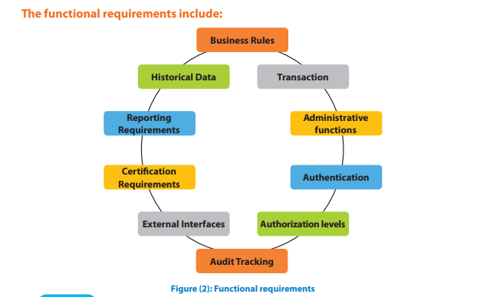
Functional Requirements include:

Slide 4
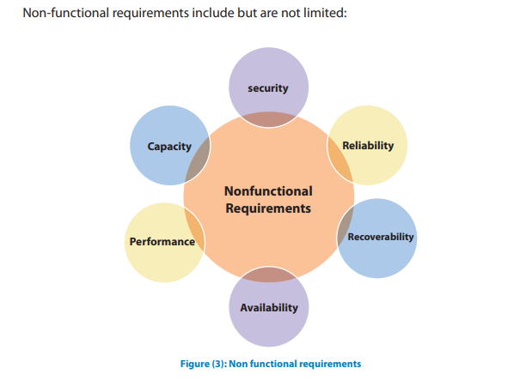
Non-functional requirements are separated into two main categories: Execution: qualities like speed, security, and usability can be observed at run time Evolution :qualities like testability, maintainability, extensibility

Slide 5
Documenting Program Requirements
A-Importance of Documenting Requirements
it is easier to perform things when requirements are defined and documented properly, from the business analyst to the client. It aids in improving estimations, cutting expenses, raising user happiness, and cutting down on project time.
B- Functional Requirements Document (FRD)
A formal document outlining the requirements necessary to fulfill business demands is called a Functional Requirements Document (FRD). The document fulfills the function of a contract by allowing the customer to specify the terms that they think are appropriate given the capabilities of the final product.

Slide 6
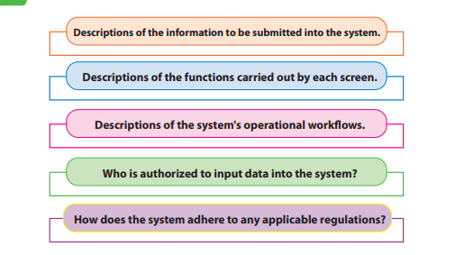
The functional requirements document should include the following aspects:

Slide 7
C-Functional Requirements Document Modules
Functional Requirements
Non-Functional Requirements
Data requirements:
The data that the system must be able to support are described in this FRD section.
2-Process requirements:
Text, data flow diagrams, or any other tool that may convey important details about the processes the product supports may be used to demonstrate process requirements.
Security
Reliability
Recoverability
Availability
Performance
Capacity

Slide 8
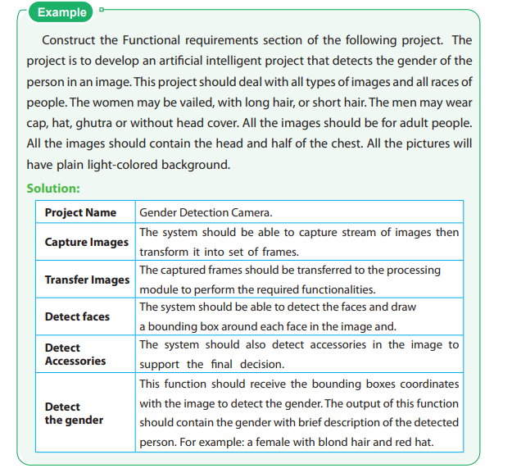

Functional Requirements

Slide 9
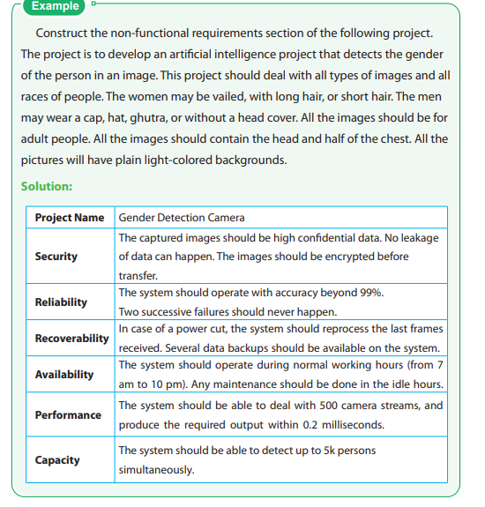
Non-functional Requirements

Slide 10
Complexity
Time
space

Slide 11
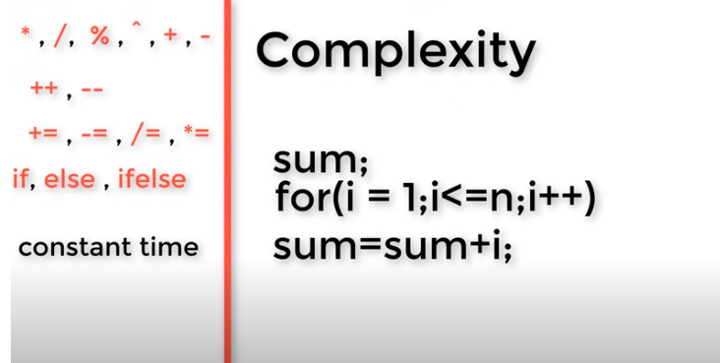
Example 1

Slide 12
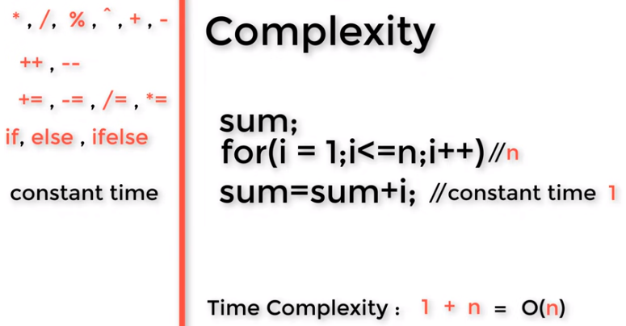
Solution

Slide 13

Example 2

Slide 14
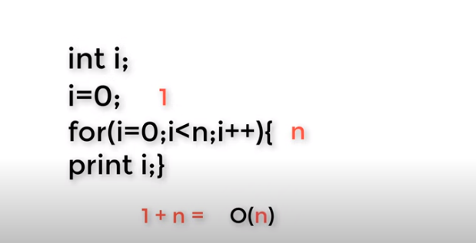
Solution

Slide 15
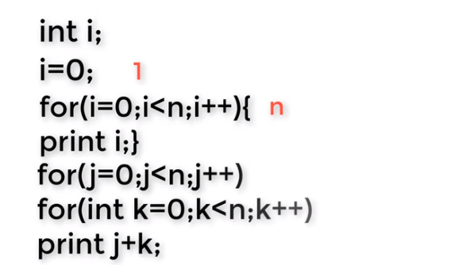
Example 3

Slide 16
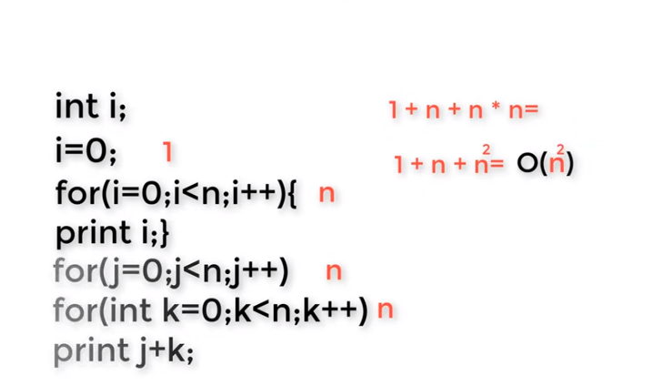
solution

Slide 17
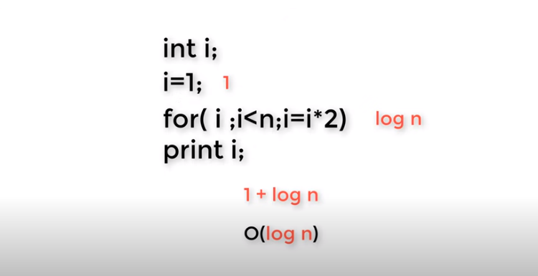
Example 4

Slide 18
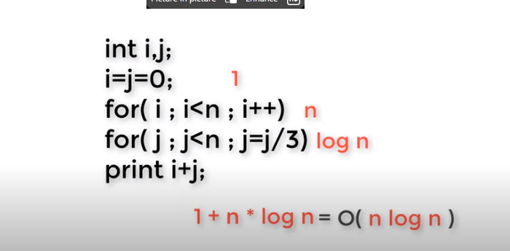
Example 5

Slide 19
BRUTE FORCE (Exhaustive search)

Slide 20
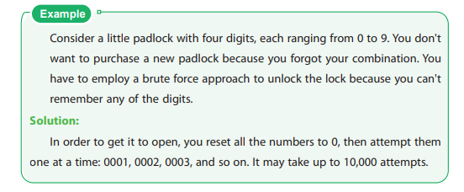
Example

Slide 21
Advantages and disadvantages of brute force algorithm:
ADVANTAGES:
1. THE BRUTE FORCE METHOD IS A GUARANTEED TO FIND THE RIGHT ANSWER.
2. IT IS A GENERAL APPROACH THAT CAN BE USED FOR A VARIETY OF ISSUES.
3. THE BRUTE FORCE APPROACH WORKS WELL WHEN DEALING WITH STRAIGHTFORWARD, SMALL PROBLEMS.
4. IT IS FAMOUS FOR BEING STRAIGHTFORWARD AND CAN BE USED AS A STANDARD FOR COMPARISON.

Slide 22
ADVANTAGES AND DISADVANTAGES OF BRUTE FORCE ALGORITHM
Disadvantages
1. The use of brute force is ineffective.
2. This approach depends less on an effective algorithm design and more on a computer system's ability to solve a task.
3. Brute force methods are slow.
4. Compared to algorithms built utilizing certain other design paradigms, brute force algorithms are not creative or productive.

Slide 23
Divide and Conquer
1. Divide the problem into small distinct subproblem(s).
2. Conquer the subproblems by solving them recursively in the same manner.
3. Combine the solution of subproblems to get the final solution

Slide 24
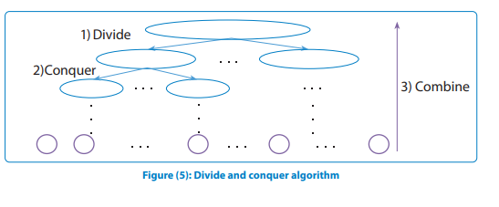

Slide 25
Advantages and disadvantages of divide and conquer algorithm:
Advantages
Disadvantages
1. Solving difficult problems
2. Parallelism
3. Memory access
The possibility of this method becoming slow is a drawback. This is due to the overhead of the frequent dividing to the subproblem. The overhead of splitting and combining can, however, become insignificant for huge tasks.

Slide 26
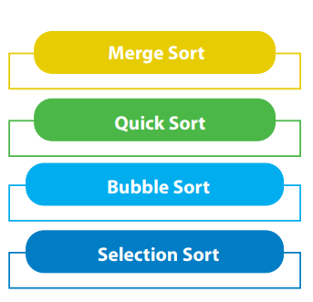
Sorting algorithms

Slide 27
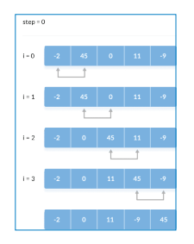
Bubble Sort: Large data sets should not be used with this approach due to its high average and worst-case time complexity
bubble sort

Slide 28
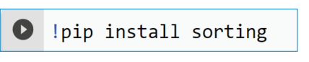
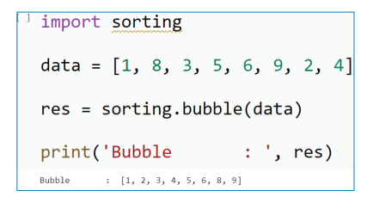
28
The complexity of bubble sort is O(n2).

Slide 29
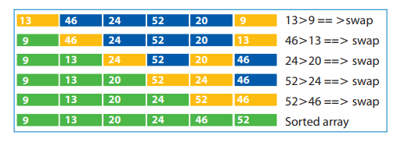
Selection Sort
selection sort

Slide 30
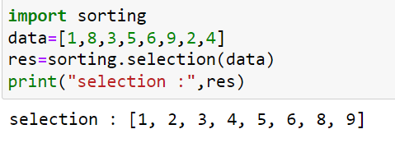
30
The complexity of bubble sort is O(n2).

Slide 31
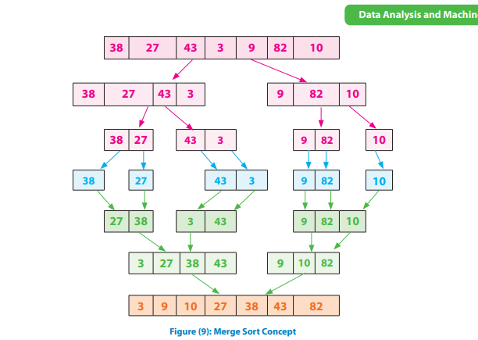
Merge sort
Sorting (Bubble, Selection, Insertion, Merge, Quick, Counting, Radix) - VisuAlgo

Slide 32
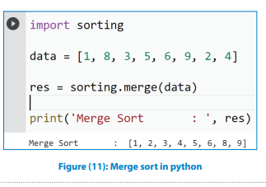

Slide 33
Quick-sort:
Concept:
Quicksort utilizes the divide and conquer strategy. A huge array is split into two smaller subarrays before being sorted recursively. As shown in figure (12), the entire method essentially consists of three steps:
• Pivot selection: Choose a pivot, or element, from the array.
• Partitioning: Rearrange the array's elements so that those with values below the pivot are placed before it. All elements, however, whose values exceed the pivot appear after it.
Any outcome is possible for the equal values. The pivot is at its final position following this partitioning.
• Recur: Repeat the previous steps for the subarray of elements with values lower than the pivot and for the subarray of elements with values higher than the pivot, respectively.

Slide 34
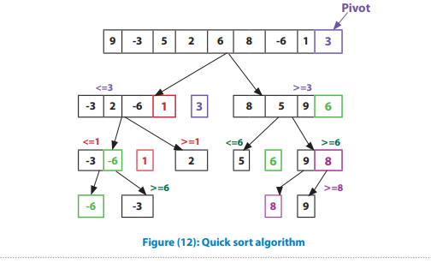

Slide 35
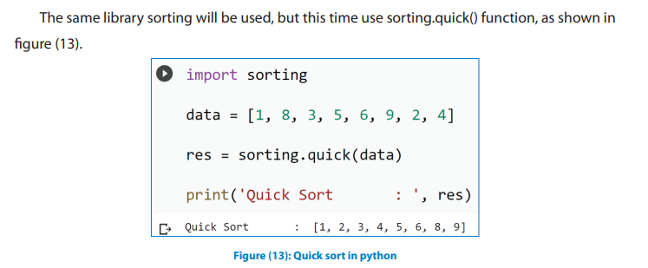

Slide 36
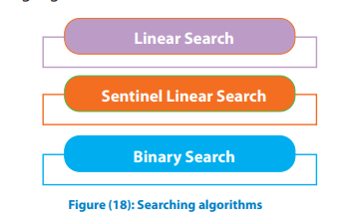
Searching Algorithms

Slide 37
1 Linear Search
Concept: A sequential search technique known as "linear search" starts at one end of a list and runs through each item in turn until the desired element is located; if not, the search continues until the end of the data set. The sequential search is the simplest search algorithm
Items are not required to be arranged

Slide 38
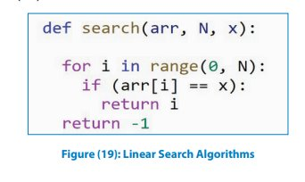

Slide 39
2 Sentinel Linear Search (Task)

Slide 40
Binary Search
Items are required to be arranged

Slide 41
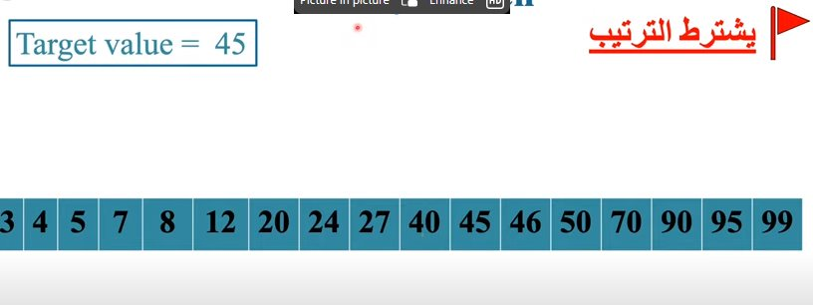

Slide 42
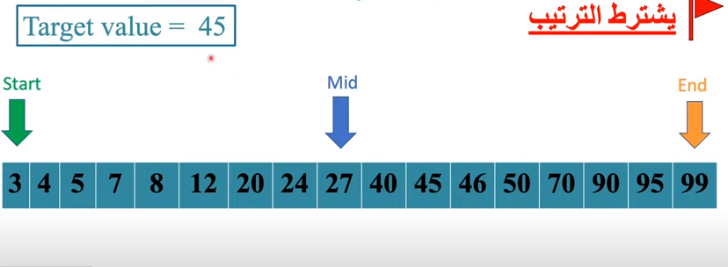

Slide 43
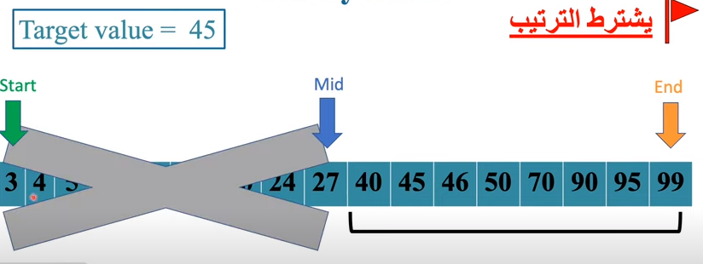

Slide 44
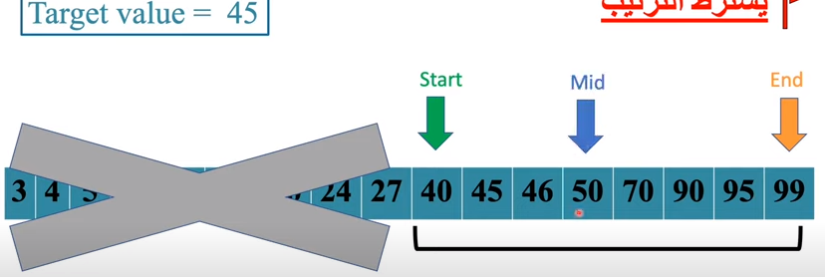

Slide 45
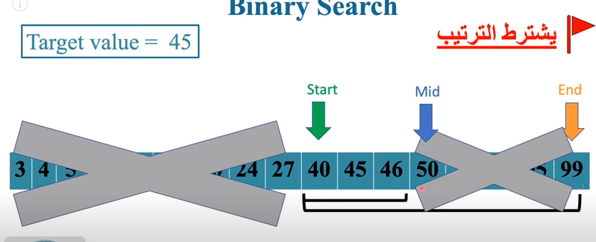

Slide 46
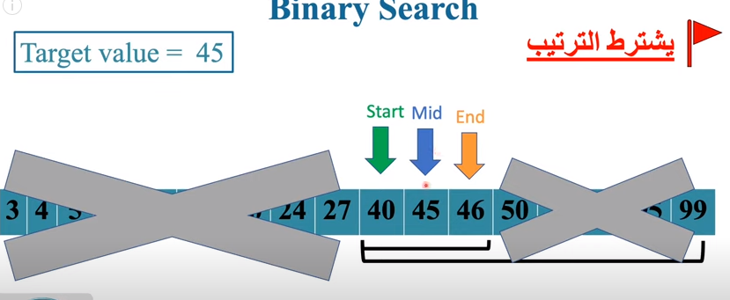

Slide 47
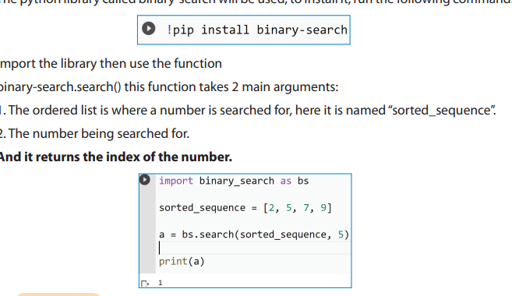

Slide 49
THANK YOU

